Slide 1

FactoryDNA Ai: manufacturing process genome learning for zero waste productions
SOA Project Review-1
Wednesday, August 19th, 2026
 | Under the Guidance of Dr. Srikanth Cherukuvada Assistant Professor, Department of Computer Science and Engineering, KLH CSE Bowrampet Campus
Team Members V. Akshitha — 2420090105 M. Suchita — 2420090122 V. Tarun — 2420090070

Slide 2
Outline of Research Work
Focus
Introduction
Literature Survey
Challenges
Research Objectives
Conclusion & Future Work
References

Slide 3
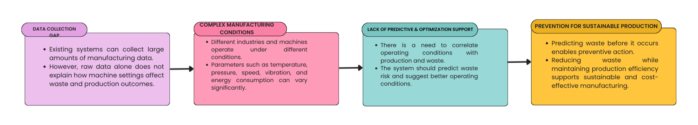
Problem Statement
1.Lack of Predictive Intelligence:
Existing systems can collect manufacturing data, but there is a need for predictive intelligence that can correlate process conditions with waste and production outcomes and support optimization.
2. Complex & Variable Manufacturing Conditions:
Manufacturing processes differ across industries and equipment, involving parameters such as temperature, pressure, speed, vibration, and energy consumption. A system is needed that can learn from process-specific data.
3. Prevention Over Cure:
Predicting waste before it occurs can enable preventive action, supporting sustainable production while reducing material waste and improving production efficiency.

Slide 4
Objectives
1. Data Collection
Collect real-time and historical manufacturing data using IoT sensors.
Capture machine settings, production yield, waste, quality, and operating conditions.
2. Process Learning
Analyze manufacturing data to learn relationships between machine settings, production output, and waste.
Develop a process-specific “Manufacturing Process Genome”.
3. Waste Prediction
Predict the risk of waste and defects based on current manufacturing conditions.
Identify abnormal or high-risk operating conditions before significant waste occurs.
4. Optimization & Recommendation
Identify process parameters contributing to predicted waste.
Recommend improved operating conditions to reduce waste while maintaining production efficiency.
5. Monitoring & Evaluation
Provide a real-time dashboard for machine conditions, waste-risk predictions, contributing factors, and recommendations.
Evaluate the system using appropriate machine-learning performance metrics.

Slide 5
Literature Survey
Authors | Title of the Paper | Methodology | Inferences | Limitation/Future work
Faisal Altarazi | Optimizing Waste Reduction in Manufacturing Processes Utilizing IoT Data with Machine Learning Approach for Sustainable Production | IoT data + deep learning (EcoEfficientNet) | Identifies patterns and areas where manufacturing waste can be reduced; includes optimization recommendations. | Focuses on a particular manufacturing case rather than a generalized SOA-based system
Tercan & Meisen | Machine learning and deep learning based predictive quality in manufacturing: a systematic review | Systematic review of 81 studies using ML/DL | Shows that process and sensor data can be used to predict product quality | Predictive quality research is spread across different processes; broader integration remains challenging
Min, Qingfei Lu, Yangguang Liu, Zhiyong Su, Chao Wang, Bo | Machine Learning based Digital Twin Framework for Production Optimization in Petrochemical Industry | Industrial IOT+ML+Digital twin framework(new method) | Demonstrates real-time data-driven production control and optimization | Focused on petrochemical production and digital-twin-based optimization

Slide 6
Research Gap Identification
1. Fragmented Solutions
Existing studies focus on individual areas such as quality prediction, maintenance, waste reduction, or production optimization.
These capabilities are often developed separately rather than as one integrated system.
2. Limited Waste-Focused Prediction
Many manufacturing AI systems focus on detecting defects or machine failures.
Fewer approaches directly connect process settings → production output → waste generation for proactive waste reduction.
3. From Prediction to Action
Predicting defects or waste is not sufficient by itself.
There is a need to identify the parameters contributing to the risk and translate predictions into actionable optimization recommendations.
4. Need for an Integrated, Adaptive System
Manufacturing conditions differ across processes and equipment.
FactoryDNA aims to combine IoT data collection, process learning, waste prediction, root-cause analysis, optimization, and monitoring within a scalable SOA-based system.
Src:https://link.springer.com/article/10.1007/s10845-022-01963-8

Slide 7
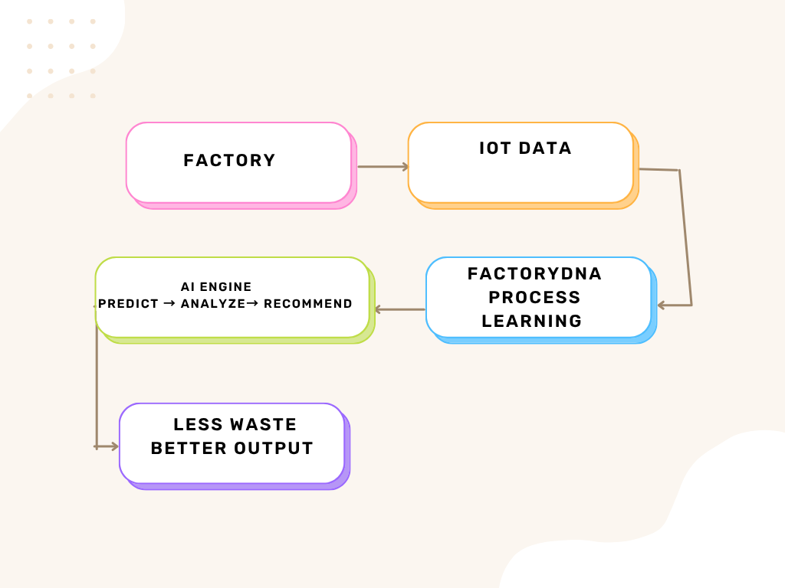
Innovation, Creativity, and Novelty
Manufacturing Process Genome
Creates a process-specific profile from historical manufacturing data.
Learns the relationship between machine conditions, production output, and waste.
2. Predictive Waste Intelligence
Goes beyond simply monitoring machine parameters.
Predicts potential waste/defect risk from current operating conditions.
3. From Prediction to Recommendation
Identifies parameters contributing to the predicted waste.
Converts AI predictions into actionable recommendations for improving machine settings.
4. Integrated SOA-Based System
Combines IoT data collection, data processing, AI prediction, optimization, and monitoring as independent services.
Allows the system to be modular, scalable, and adaptable to different manufacturing processes.

Slide 8
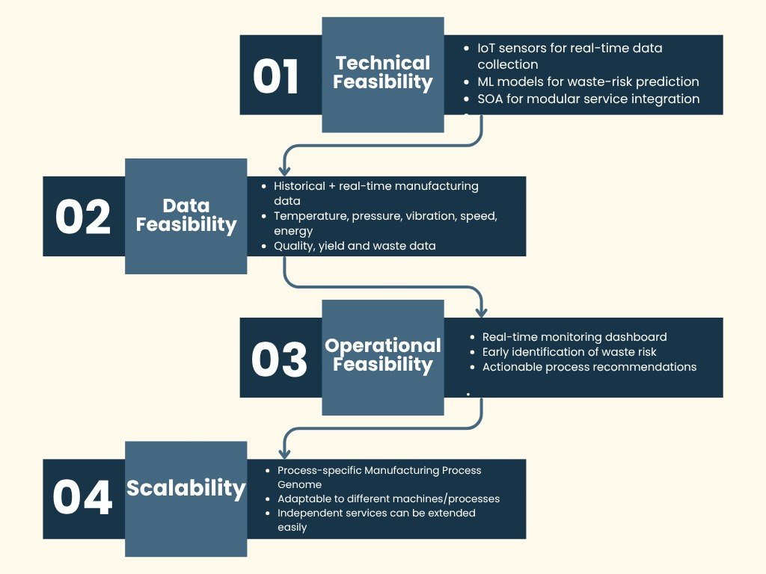
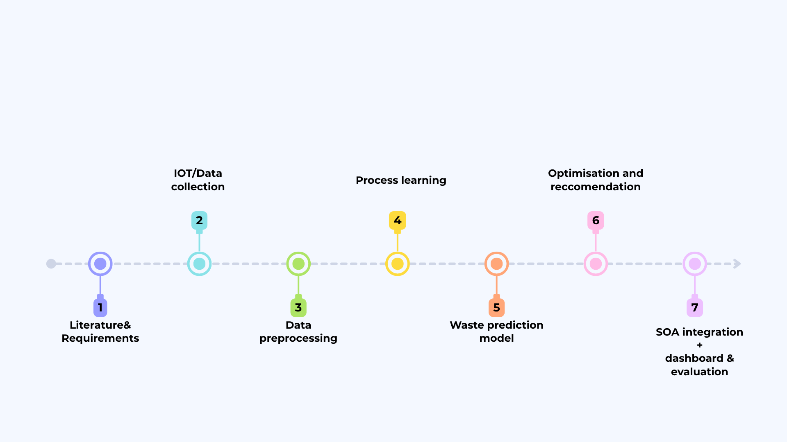
Feasibility and Project Plan

